Slide 1
DNS & Ubuntu BIND

Slide 2
Introduction
In this lecture we will firstly look at DNS in Ubuntu (BIND9)
BIND (Berkeley Internet Name Domain)
Then we will look at how we can setup
Master & Slave DNS Servers using BIND9

Slide 3
DNS & BIND9
DNS, is one of the Internet's fundamental building blocks.
The global, hierarchical, and distributed host information database that's responsible for translating names into addresses and vice versa.
BIND9 is the Ubuntu Server package that implements the DNS service.

Slide 4
DNS & BIND9
DNS servers maintain a local directory of names and IP addresses for which they are authoritative.
Many DNS servers can serve recursive requests as well.

Slide 5
DNS Record Types
Tells DNS what kind of information it is storing.
Something you can explicitly query.
Example: you can query the MX record for a domain to find out what mail server to use when sending mail to a recipient in the domain.

Slide 6
DNS Record Types
Address record
Most common record in DNS.
Used to translate a host name to an IP address.
Pointer
The reverse of an Address record.
Translates an IP address to a host name.
CNAME record
If you want to create an alias of one host to another, a CNAME entry is used.

Slide 7
DNS Record Types
MX record
Used to define a Mail Exchanger for the domain (or zone) you have created.
NS record
Used to define the nameserver for this domain.
SOA record
Start of Authority (SOA) is effectively the header for the zone in question.
Contains information about the zone itself and is mandatory.

Slide 8
Working with Zones
Zone
Description, or a definition, of a domain (or subdomain).
What makes up the database records for a domain.

Slide 9
Working with Zones
Zone files
Separate files located in /etc/bind
Text files containing the data for the zone.
BIND defines its zones in /etc/named.conf.default-zones by specifying the location of these zone files.

Slide 10
Zone Example
We will look at how a DNS zone is constructed and what information you can store for a specific zone.
We use mynewsite.ie as an example of a zone and will go through the DNS records and explain their uses.

Slide 11
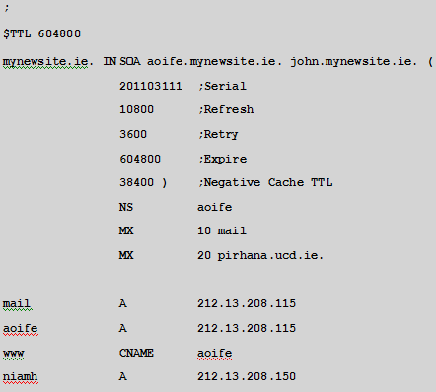
Zone Example

Slide 12
Zone Example
Start of Authority (SOA)
That this zone is authoritative for the domain in question, mynewsite.ie.
Ends in a full stop: the delimiter for the end of the DNS tree
E.g. the aoife record listed at the end in the example, the SOA’s domain will be appended to the host name in the record. = aoife.mynewsite.ie

Slide 13
Zone Example
SOA Server
server that is authoritative for the domain.
BIND is aware that it needs to find the IP address for the server from its zone file.

Slide 14
Zone Example
Hostmaster
The hostmaster for the mynewsite.ie zone is john.mynewsite.ie (john@mynewsite.ie).
You will notice that there is no @ sign in the email address, but a full stop.

Slide 15
Zone Example
SOA Record
The brackets around the rest of the data dictate that everything else up to the closing bracket is part of the SOA record.
All time settings are in seconds.

Slide 16
Zone Example
Serial Number
tells other DNS servers that are querying your DNS server that data has changed.
must be changed any time you edit the zone file.
If not, your changes will not get propagated through the system.

Slide 17
Zone Example
Refresh Rate
If you have a slave DNS server, the refresh rate tells the slave server how often to check for updates to the zone.
Retry Rate
If your slave server cannot contact the master, the retry rate is how often it will attempt to contact the master.

Slide 18
Zone Example
Time to Live (TTL)
The amount of time before a name server that has requested a record considers it stale
NS Entry
Every zone should have an NS entry (nameserver), and in this case, the nameserver for mynewsite.ie is the machine aoife .
Remember that with no full stop, it gets expanded to aoife.mynewsite.ie

Slide 19
Mail Exchanger
To receive mail for your domain, you must specify an MX record for it.
Defines the host that receives mail for this domain.

Slide 20
Mail Exchanger
To receive mail for your domain, you must specify an MX record for it.
Defines the host that receives mail for this domain.
For Example: When an SMTP server needs to find the host that handles mail for a domain, it will query the MX record for the machine to connect to.

Slide 21
Zone Example

Slide 22
Mail Exchanger
In the MX record in the example the number in the second field indicates the preference order for the MX host specified.

Slide 23
Mail Exchanger
In the MX record in the example the number in the second field indicates the preference order for the MX host specified.
The lower the number, the higher the preference.

Slide 24
Mail Exchanger
In the MX record in the example the number in the second field indicates the preference order for the MX host specified.
The lower the number, the higher the preference.
So in this case, all SMTP transactions for this domain will attempt to connect to mail.mynewsite.ie, and if that fails they will try the machine pirhana.ucd.ie (the backup MX server)

Slide 25
Installing BIND
Install during the initial Ubuntu install
use tasksel.
Alternatively you can just run
# apt-get install bind9 bind9-doc
This default setup configures a caching name server for recursive queries.

Slide 26
BIND File Locations
/etc/bind/
Contains the main BIND configuration file, named.conf, as well as any individual zone files.

Slide 27
BIND File Locations
/etc/bind/db.*
all zone files start with db.
Names are typically used when the zone contains traditional forward DNS records (names mapped to IPs), and numbers are typically used for reverse DNS records (IPs mapped back to a name).

Slide 28
BIND File Locations
/var/cache/bind
BIND’s working directory & where it will store slave zone files.
If your server will act as a slave for a particular zone, configure it to store its files here.

Slide 29
BIND File Locations
/etc/init.d/bind9
BIND’s init script.
Once you install the bind9 package, it will automatically be set up to start on system boot, but you can run the init script manually with /etc/init.d/bind9, or service bind9.

Slide 30
DNS Master
Caching name servers are very useful, but when most people install BIND, they intend to host some zone files of their own.
When a name server hosts zone files locally and doesn’t need to retrieve them from any other source, it is known as a master.

Slide 31
DNS Master
To add a zone to a DNS Server:
Create a Zone File
Add a reference to that zone file in named.conf.default-zones
Tell BIND to reload its configuration.

Slide 32
DNS Master
To add a zone to a DNS Server (Example):
name server inside my network at 192.168.0.5
I registered mynewsite.ie.
I want this name server to have the following entries:
ns1.mynewsite.ie points to192.168.0.5(the nameserver itself).
www.mynewsite.ie points to192.168.0.7.
gw.mynewsite.ie points to192.168.0.1.

Slide 33
DNS Master
To add a zone to a DNS Server (Example):
To begin, the simplest way to create a Zone file is to copy one you already have and change it.
In this case the best candidate is the /etc/bind/db.local file, so I copy it to db.mynewsite.ie:
# cp /etc/bind/db.local /etc/bind/db.mynewsite.ie

Slide 34
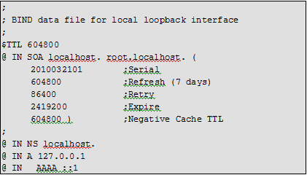
Add a zone to a DNS Server (Example)
When I open db.mynewsite.ie in a text editor, I will see the following configuration:

Slide 35
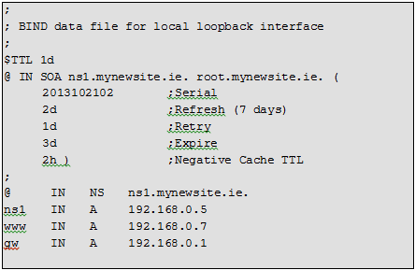
Add a zone to a DNS Server (Example)
The file lists localhost as a name server for this zone with an NS record, then sets localhost’s IP address to be 127.0.0.1 and even adds an IPv6 address for localhost with the AAAA record. We have changed this record to suit the requirements I set out previously, and this is the resulting zone file:

Slide 36
Add a zone to a DNS Server (Example)
I set ns1.mynewsite.ie as the SOA and root@mynewsite.ie as the contact e-mail address. I also set ns1.mynewsite.ie as the name server to use for this zone, but notice that the NS record references the name of the host.

Slide 37
Add a zone to a DNS Server (Example)
Since this name server is in the same domain, mynewsite.ie, I needed to make sure I added a record for it here that listed its IP address. Also note that I didn’t need to add .mynewsite.ie to any of the A records.

Slide 38
Add a zone to a DNS Server (Example)
Be sure once you save your zone file that it has the same permissions and ownership as the other zone files in the directory—that’s the best way to avoid any permission headaches later on once you reload BIND.

Slide 39
Add a zone to a DNS Server (Example)
Now that I have created the zone file, I need to add a reference to it in named.conf.default-zones. When I open it with my text editor, I can see a number of similar zone examples such as the one for the db.local file:
zone "localhost" { type master;
file "/etc/bind/db.local";
};
So I just add a similar entry to the very bottom of the file:
zone "mynewsite.ie" { type master;
file "/etc/bind/db.mynewsite.ie";
};

Slide 40
Add a zone to a DNS Server (Example)
Now reload the BIND configuration
# service bind9 reload
You should now be able to query the name server for one of the new records:
# nslookup www.mynewsite.ie localhost
Server: localhost
Address: 127.0.0.1#53
Name: www.mynewsite.ie
Address: 192.168.0.7

Slide 41
DNS Slave
A DNS Server that retrieves its zone information from a different DNS server known as a slave.
The DNS Server that gives it the zone information is known as the master.
Simplifies your DNS administration because you have to update zone information only on the master and it automatically propagates to the slaves (On the master increment the serial number inside that zone, & reloads BIND – update then occurs automatically)

Slide 42
Configuring BIND on a Slave
Slave DNS server retrieves its zone information from the master
its configuration is much simpler
Provided the master is configured to allow zone transfers from the slave, on the slave you simply have to add an entry to named.conf.default-zones.

Slide 43
Configuring BIND on a Slave
Example:
To add to a second name server to our previous example
ns2.mynewsite.ie at 192.168.0.10.

Slide 44
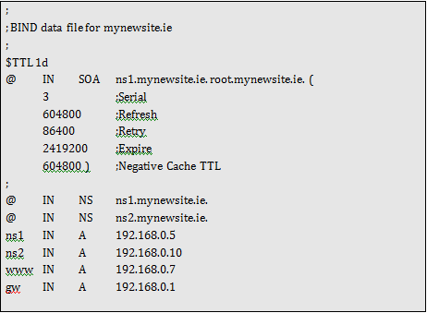
Configuring BIND on a Slave (Example)
On my master server, 192.168.0.5, I would need to edit my db.mynewsite.ie file and add the references to ns2.mynewsite.ie

Slide 45
Configuring BIND on a Slave (Example)
Also on the master: Now I need to add a line to the mynewsite.ie configuration in named.conf.default-zones so that it allows zone transfers to 192.168.0.10, so mynewsite.ie’s entry in named.conf.default-zones becomes:
zone "mynewsite.ie" {type master;
file "/etc/bind/db.mynewsite.ie";
allow-transfer {192.168.0.10;};
};

Slide 46
Configuring BIND on a Slave (Example)
Now on the Slave Server:
I install the bind9 package either through tasksel or apt-get, and then all I need to do is add a slave entry for mynewsite.ie at the bottom of /etc/bind/ named.conf.default-zones:
zone "mynewsite.ie" { type slave;
file "/var/cache/bind/db.mynewsite.ie";
masters {192.168.0.5;};
};

